Slide 1
Field Orientation
Part II
graduate
School of Social Work and Family Sciences

Slide 2
Welcome to Field
MSW Field Coordinator
  Monica Ascar, MSW, LISW-S
  mascar@uakron.edu
  Phone: 330-515-
School of Social Work and Family Sciences

Slide 3
Field Overview
Field education, the signature pedagogy for social work education
  Provides an opportunity to demonstrate learning through practical experiences
  Integrates classroom knowledge into "real world" situations
  Development of professionalism, professional boundaries, and a teachable attitude.
  Strengthening your skill-set in the four social work core areas: Engage, Assess, Intervene, and Evaluate
School of social Work and family sciences

Slide 4
Field Orientation Part I Review
Field Education Structure
School of social work and family sciences

Slide 5

Signature Pedagogy
Theoretical & conceptual contributions
“real world” experiences
School of Social Work and Family Sciences

Slide 6
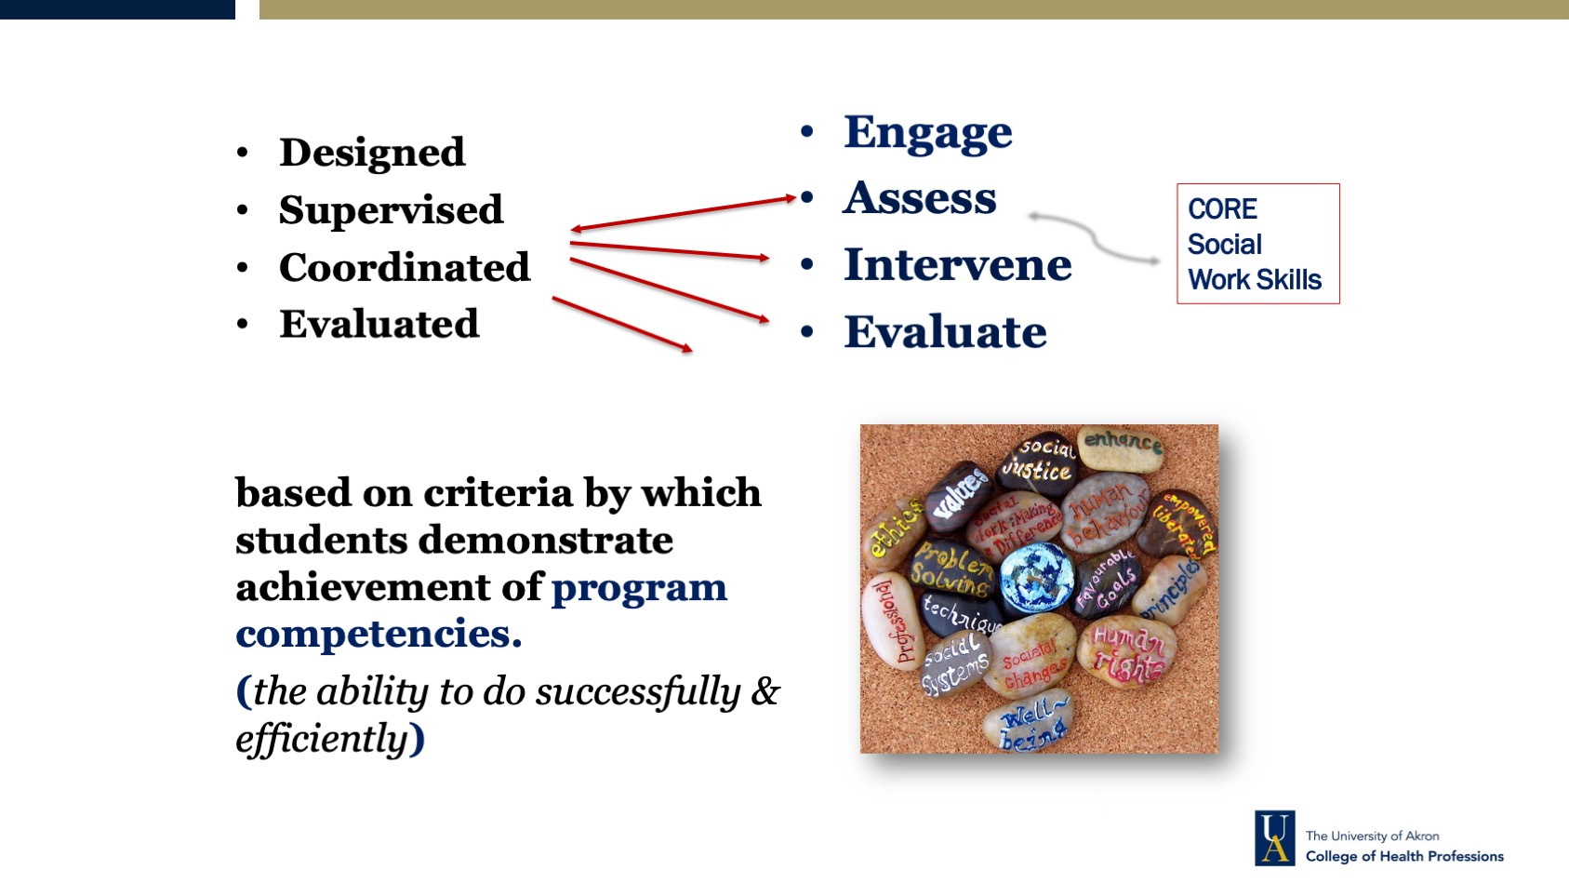
SCHOOL OF SOCIAL WORK AND FAMILY SCIENCES

Slide 7
Signature Pedagogy
Theoretical & conceptual contributions
“real world” experiences
School of Social Work and Family Sciences

Slide 8
Field Education Structure and expectations for MSW
Grade structure – Pass or Fail​ (Credit or No Credit​)
No Credit or Fail = repeat field education​
Credit = Pass​
1 min hour of weekly supervision with field instructor​
1 Required visit by Faculty Field Liaison per semester
School of Social Work and Family Sciences

Slide 9
Field Education Structure and expectations for MSW
Two consecutive semesters​
Generalist (Foundation) students
  Must complete 200 hours per semester- 16 hours per week​
Specialist (Concentration) students
  Must complete 250 hours per semester- 17 hours per week
3 credit hours per semester for field education
School of social work and family sciences

Slide 10
Field Education Structure and expectations: Generalist (Foundation) Year
Two consecutive semesters​
Field begins at the start of the semester
Generalist (Foundation)-Full-time Student
  1st year-1st placement​
Generalist (Foundation) – Part-time Student
  2nd year – 1st placement
School of social work and family sciences

Slide 11
Field Education Structure and expectations: Specialist (Concentration) Year
Two consecutive semesters​
Field begins at the start of the semester
Specialist (Concentration)-Full-time Student
  2nd year- 2nd placement​
Specialist (Concentration) – Part-time Student
  2nd year – 1st placement
Specialist (Concentration) Advanced Standing
  1 year program – 1 field placement only
School of social work and family sciences

Slide 12
Field Supports
Background Checks/Fingerprinting
Immunizations/Tuberculin Skin Testing
Professional Liability Insurance
Social Work Trainee License
Please contact the MSW Field Coordinator and visit our field webpage https://www.uakron.edu/socialwork/field-education/msw-field-forms.dot for additional information of these field supports
School of social work and family sciences

Slide 13
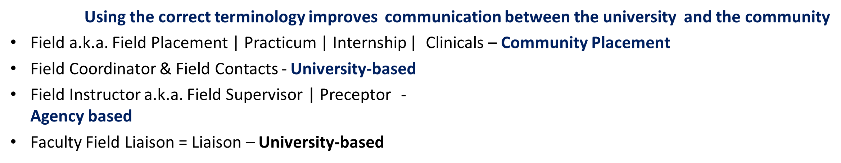

Field education terminology
School of social Work and family sciences

Slide 14
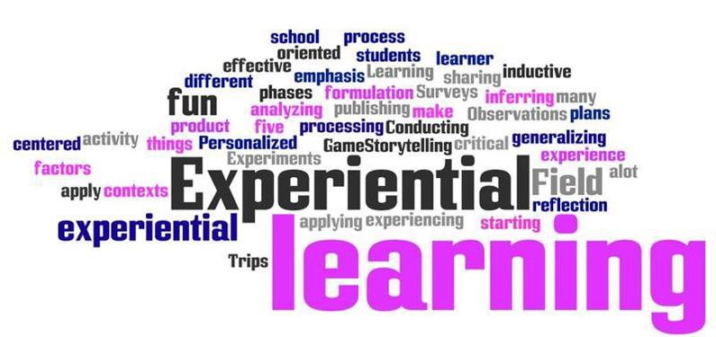

School of Social Work and Family Sciences

Slide 15
Field Documentation
School of Social Work and Family Sciences

Slide 16
Field Documentation
Hours Log’s
Narrative Log’s
Achievement Measures of Field Education (AMFE)
  Documentation of activities and strategies to learn skills across the nine social work competencies
  Student baseline assessment
  Student and Field Instructor semester assessment and evaluation of skill acquisition
Tevera
  The submission process for all Field Education documents is completed using a cloud-based platform called Tevera
  Students will view a series of Tevera instructional videos in Part II of the field orientation in Brightspace
School of social work and family sciences

Slide 17
Hours Log
What is an Hours Log?
An hour's log is a tool used to document a student’s weekly activities directly connected with developing competency in the identified Learning Activities in the AMFE tool. The hours log is the place to document the amount of time required to complete those tasks associated with moving from unskilled to competent practice.
Who completes the Hours Log?
The Hours logs are completed and signed by the student then routed for signatures in order from field instructor to then faculty liaison. If student also has a task supervisor, this person may review and sign as well.
When do I complete the Hours Log?
Each log covers four weeks of documentation of time. A student is to submit an Hours log to their field instructor every four weeks for a field instructor’s signature.
School of social work and family sciences

Slide 18
Hours Log
Does the Hours Log require signatures?
Yes. Each student’s field instructor, the student, and the faculty liaison will need to place their signature on each set of hours logs.
When are signatures required?
Each agency may work differently. However, each student should sign their hours logs every four weeks. Field instructors and liaisons will sign after they review and approve the log.
The university requires hours log at specific dates/time frames as documented on the field calendar. However, all students must submit every four (4) weeks. (See field calendar for when hours logs are due to the university)
What goes into the Hours Log?
The exact amount of time at your field placement: Including time in field (called time at site) and supervision hours each week.
If students use Holiday (specific national holiday when field agency is closed) or sick hours, these must be documented on the hours log on the date in which they are used and indicated as “time at site.” Students then use the accompanying narrative log to specify that time was used due to the holiday or student illness.
School of social work and family sciences

Slide 19
Narrative Log
What is a Narrative Log?
A narrative log is a tool used to document a student’s weekly activities directly connected with developing competency in the identified Learning Activities in the AMFE tool. The narrative log is the place to document the specifics activities each week that are related to the learning activities associated with moving from unskilled to competent practice.
Who completes the Narrative Log?
Narrative logs are completed and signed by then student then routed for signatures in order from field instructor then to faculty liaison. If student also has a task supervisor, this person should review and sign as well.
When do I complete the Narrative Logs?
Each log covers four weeks of documentation of activities completed in field. A student is to submit a Narrative log to their field instructor every four weeks for a field instructor’s signature.
School of social work and family sciences

Slide 20
Narrative Log
Do the Narrative Logs require signatures?
Yes. Each student’s field instructor, the student, and the faculty liaison will need to place their signature on each set of narrative logs.
When are signatures required?
Each agency may work differently. However, each student should sign their hours logs every four weeks. Field instructors and liaisons will sign after they review and approve the log.
The university requires narrative logs at specific dates/time frames as documented on the field calendar. However, all students must submit every four (4) weeks. (See field calendar for when hours logs are due to the university)
What goes into the Narrative Log?
The specific details of activities you completed each week at your field placement: Including activities completed in field, any trainings/conferences attended and what was learned as well including what was covered and planned during supervision hours each week. A student should have no less than 6-9 sentences for one week reflecting the detailed activities so it can be clearly connected with the established learning activities.
School of social work and family sciences

Slide 21
Achievement Measure of field Education (AMFE)
The AMFE is used to capture the following:
  Documentation of activities and strategies (Learning Activities) student will complete over the course of two semester’s
  Student baseline assessment
  Student and field instructor assessment and evaluation of skill acquisition following each semester in field
  The AMFE is an excel document at that is uploaded into Tevera
School of social work and family sciences

Slide 22
Achievement Measure of field Education (AMFE)
Learning Activities
Student Learning Activities is part of the AMFE tool used to document the learning plan for each student. This plan is divided into specific behaviors under each of the nine (9) competencies. The Learning Activities in the AMPFE tool serve as a written contract approved by the field instructor/agency, faculty liaison/university and the social work student detailing what opportunities need to happen to ensure that the student develop the emerging level competencies required of all graduating social work students.
During the first month of placement, Student and Field Instructor collaborate to generate a minimum of ONE (1) Learning Activity for each social work Behavior, for a grand total of at least 31 Learning Activities.
Learning Activities should be written in a format that is SMART = Specific, Measurable, Attainable, Relevant, Timely
School of social work and family sciences

Slide 23
Achievement Measure of field Education (AMFE)
Learning Activities Continued
Each learning activity must address one of the four dimensions - Any learning activity can be written with a focus on any Dimension, but a minimum of 4 learning activities must be written for each Dimension. 4 Learning activities = Knowledge (K); 4 learning activities = Values (V); 4 learning activities = Skills (S); and 4 learning activities = Cognitive/Affective Processes (C/A). Remaining learning activities may be written within any Dimension. Dimensions are: Knowledge (K), Values (V), Skills (S), and Cognitive/Affective Processes (C/A)
This is explained further in the document tutorial, within the AMFE instruction guidelines, and on the field webpage.
School of social work and family sciences

Slide 24
Achievement Measure of field Education (AMFE)
Learning Activities Continued
When do I complete the Learning Activities?
  Students should have a completed (agreed upon by both the field instructor and the student) plan within the first four weeks of the first semester the student begins their field experience. See Field Calendar for exact due date.
How often do I create the Learning Activities?
  Each AMFE tool covers an entire academic year, two consecutive semesters. However, Learning Activities can be revised any time during the two semesters up until the end of the fourth week of the second semester.
School of social work and family sciences

Slide 25
Achievement Measure of field Education (AMFE)
Learning Activities Continued
How do I use this Learning Activities?
  Students will review this plan to ensure that they have opportunities to develop the identified social work skills. This plan is also used by both the student and the field instructor, in conjunction with the student evaluations, to determine how well you, the student, are growing and developing.
How do I create my customized Student Learning Activities?
  Meet with field instructor and discuss your interests and then listen to your field instructor describe the opportunities available at the agency.
  Read the how-to guide to complete the AMFE.
  Begin to create your Learning Activities in the first week- it takes time and should take time!
School of social work and family sciences

Slide 26
Achievement Measure of field Education (AMFE)
Student Baseline Assessment
Complete by the end of the first four (4) weeks of the semester field begins and concurrently, if needed, with the finalization of the learning activities.
  As placement begins, Students in conjunction with their Field Instructors are invited to reflect on each social work Behavior (31) distributed among nine (9) Competencies
  Students and Field Instructors should jointly assess the student’s current level of capability of each Behavior using the scale above (1-4, or X)
  The score should be placed in the light green Baseline column, replacing the "0's".
  Students and field instructors should strive to candidly rate their capabilities by considering past classroom performance, feedback, and self-awareness
  The Baseline Assessment, when complete, will assist the Field Instructor in better understanding the Student's strengths and challenges, and help the Student in developing Learning Activities for Field
School of social work and family sciences

Slide 27
Achievement Measure of field Education (AMFE)
Student and Field Instructor Mid-point and End-point Evaluation
MIDPOINT FORMATIVE ASSESSMENT AND GRADE RECOMMENDATION - Complete within the last two weeks of the first semester
  Student and Field Instructor will independently score the Student's level of performance for each social work Behavior, in the appropriate blue column. To do so, replace the "0" with an X, or a number 1 - 4, referencing the scale above
AMFE-E: ENDPOINT SUMMATIVE ASSESSMENT AND GRADE RECOMMENDATION – Complete within the last two weeks of the second/final semester
  Student and Field Instructor independently score the Student's demonstrated level of competence for each social work Behavior in the appropriate peach column. Do so by replacing the "0" with a number between 1-4.
  Important Note: X cannot be used on this ENDPOINT assessment, as the Student should have completed all Learning Activities, providing enough data for a final achievement score for each Behavior.
The AMFE instructional guide provides additional guidance on completing midpoint and endpoint evaluations.
School of social work and family sciences

Slide 28
Achievement Measure of field Education (AMFE)
AMFE and Tevera
At present, the AMFE tool must be uploaded into Tevera after the baseline, midpoint, and endpoint evaluations – Three uploads total.
  There will be assignments in Tevera for each upload
School of social work and family sciences

Slide 29
Tevera
Please watch the Tevera “how to” videos in Part II of the Brightspace Field Orientation
There is a one-time fee of $203 ($195 plus $8 processing fee).
Students who have paid the fee previously (as undergraduate or foundation year graduate learners in our program) DO NOT have to pay again.
Those who need to pay must pay this fee prior to beginning field.
Students will be notified when they are able to register for Tevera. You will receive a separate email about registering and paying for this when you are registered.
https://uakron.tevera.app/#/logon
School of social work and family sciences

Slide 30

Now it is time to practice completing field documentation
Go to the field education webpage https://www.uakron.edu/socialwork/field-education/
Locate your program (MSW)
Select Orientation Pre-Placement Activities
Complete the Online Experiential Activity Part 2
Once the activity is complete, please locate and sign the Signature Page for Part 2 Orientation
Submit the signature page to the MSW field coordinator prior to the start of the semester you begin field
School of Social Work and Family Sciences

Slide 31


School of Social Work Website
www.uakron.edu/socialwork/
Field Education
https://www.uakron.edu/socialwork/field-education/
MSW Field Education & Forms
https://www.uakron.edu/socialwork/field-education/msw-field-forms.dot
School of Social Work and Family Sciences

Slide 32
School of Social Work and Family Sciences

